Slide 1
ONLINE FOOD ORDERING SYSTEM
STUDENT DETAILS :AADITYA KUMAR (201010201), APOORWA GUPTA (201010212) & REVANT S EMANY (201000042)
International Institute of Information Technology, Naya Raipur

Slide 2
ONLINE FOOD ORDERING SYSTEM
CONTENTS
Abstract and Introduction
Modules
Tools used
Flow of Activities
Features
Results

Slide 3
ONLINE FOOD ORDERING SYSTEM
ABSTRACT
The following project is based on the online food delivery concept with at wits to modify it to the hotel management level.
Our proposed system is an online food ordering system that enables ease for the customers. It overcomes the disadvantages of the traditional queuing system and is a medium to order online food hassle free from restaurants.
This system improves the method of taking the order from customer.
It sets up a food menu online and customers can easily place the order as per their wish. Also with a food menu, customers can easily track the orders.

Slide 4
ONLINE FOOD ORDERING SYSTEM
MODULES COMPLETED
We have completed four modules
1st is registration page: containing username, name, password and phone no.
2nd is log in page: After registration go for login by username and password
3rd is Order food page which contain food to order, price per quantity and quantity you want to order
4th is order history page where customer can see his order history

Slide 5
ONLINE FOOD ORDERING SYSTEM
Web Ordering System Module:
Create an account,Manage it and Log in to the system.
Select an item from the menu.
Add an item to their current order.
Review their current order.
Remove an item/remove all items from their current order.
Place an order and View order placed.
Receive confirmation in the form of an order number.

Slide 6
ONLINE FOOD ORDERING SYSTEM
2. Menu Management System Module: Add/update/delete food category to/from the menu. • Add /update/delete food item to/from the menu. • Update price for a given food item. • Update additional information (description, photo, etc.) for a given food item.
3. Order Retrieval System Module: This is the most simplest module out of all 3 modules. It is designed to be used only by restaurant employees, and provides the following functions:
Retrieve new orders from the database.
Display the orders in an easily readable, graphical way.

Slide 7
SOCIAL IMPACTS
The online Food Delivery and its delivery persons provided an important lifeline during the 2020 COVID-19 pandemic for tens of millions of people isolated at home. Online Food Delivery not only provides meals but also provides jobs for people who prepare or deliver food.
In terms of social sustainability, online Food Delivery platform providers could help to tackle the food waste problem by exploring ways to better communicate with their consumers about appropriate portion sizes and to avoid pressuring or unduly incentivizing consumers to over purchase.
Online Food Delivery provides access to a wide range of meal options for those who want to eat late or want to eat alone due to work or lifestyle choices. It also eases the additional labour of sanitising and social distancing in restaurants.
.

Slide 8
TOOLS USED
ONLINE FOOD ORDERING SYSTEM
FRONT END
HTML
BACKEND
XAMAPP
PHP
TOOLS USED
XAMPP
BACK
END
ONLINE FOOD ORDERING SYSTEM
ABSTRACT
CSS
PHP
The following project is based on the online food delivery concept with at wits to modify it to the hotel management level.
JAVASCRIPT
MYSQL

Slide 9
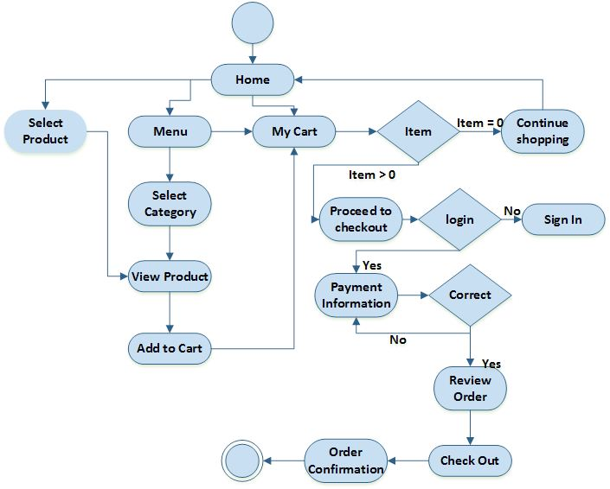
ONLINE FOOD ORDERING SYSTEM
FLOW OF THE ACTIVITIES

Slide 10
ONLINE FOOD ORDERING SYSTEM
RESULTS
The above system helps in the following ways:
a. Reduce time between order instructions and improve management.
b. Helps in economic and financial factors of the hotel.
c. Helps in building better relationships with customers.
d. Means to compete with only delivery sites on equal grounds.
e. Modernization and uplift the society

Slide 11
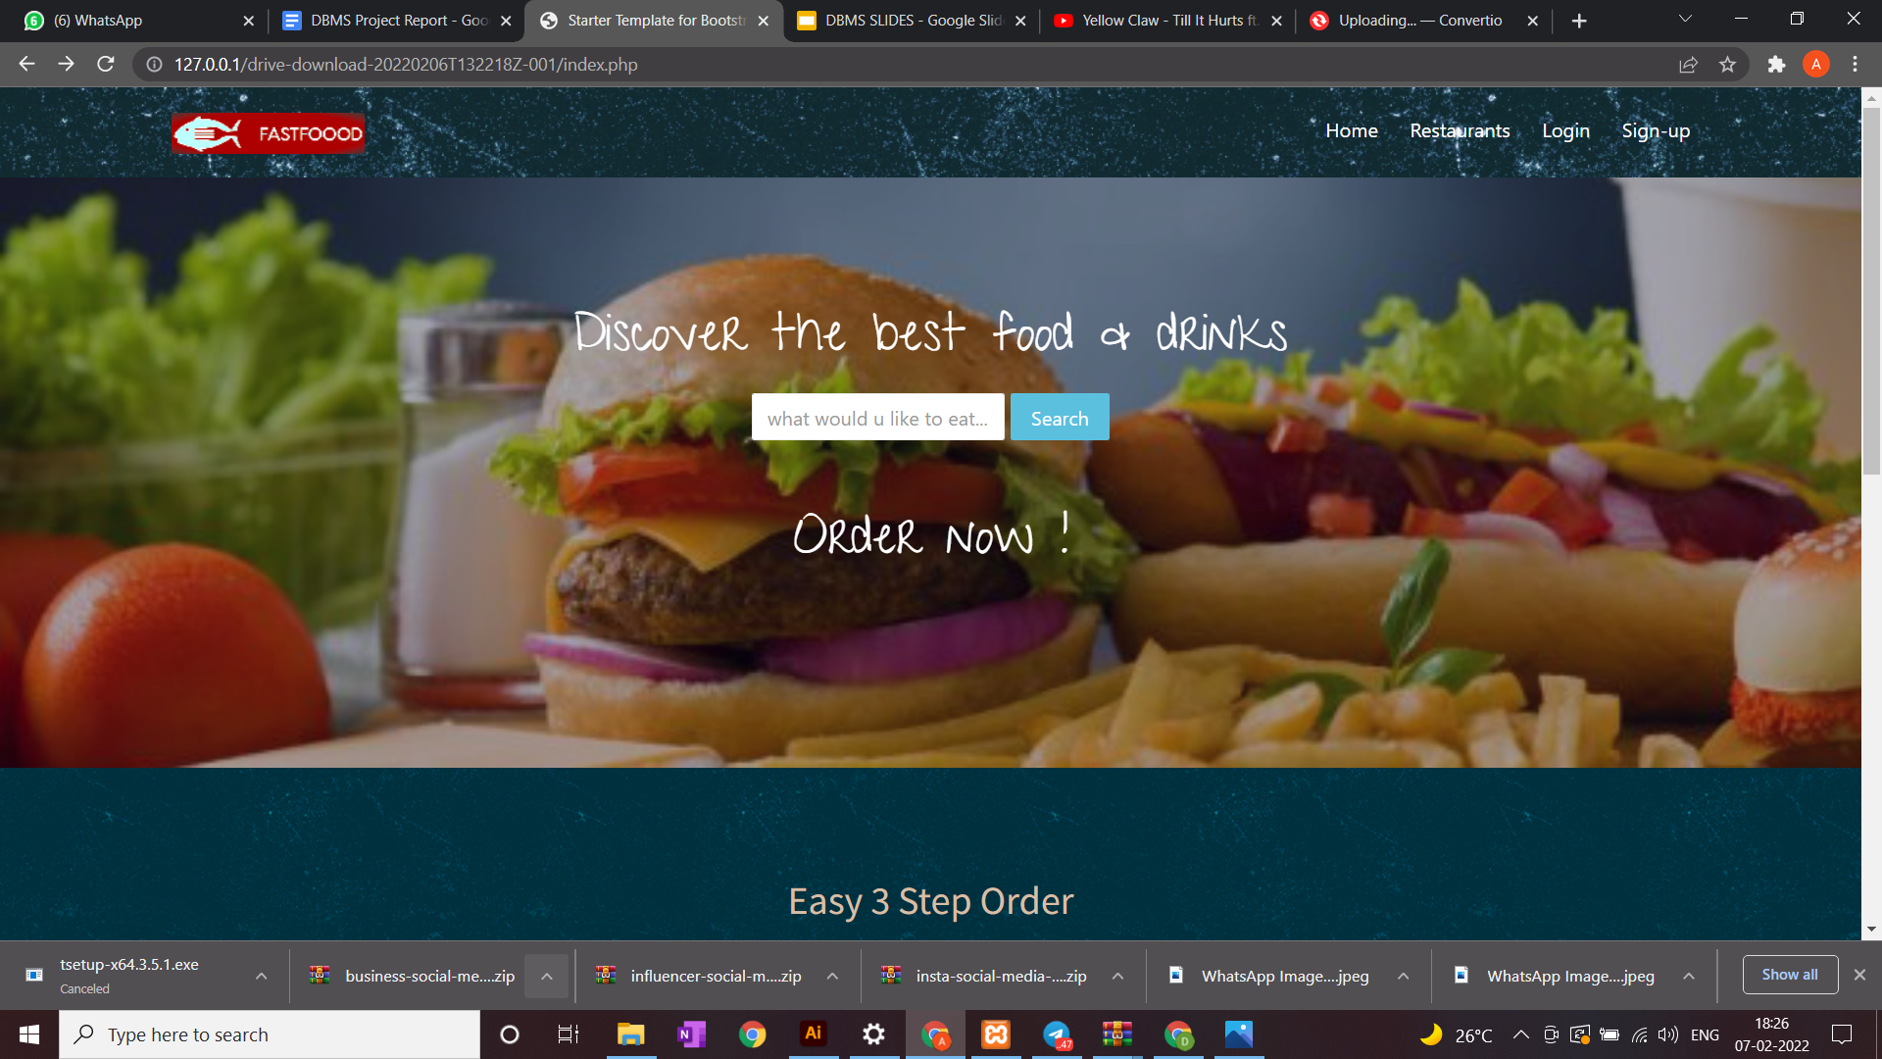
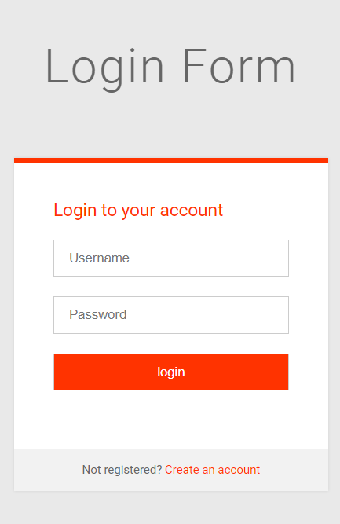
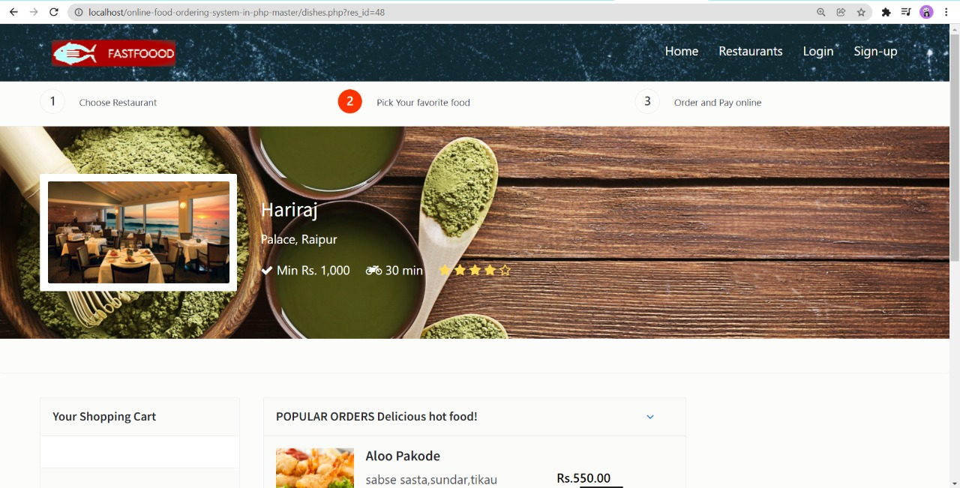
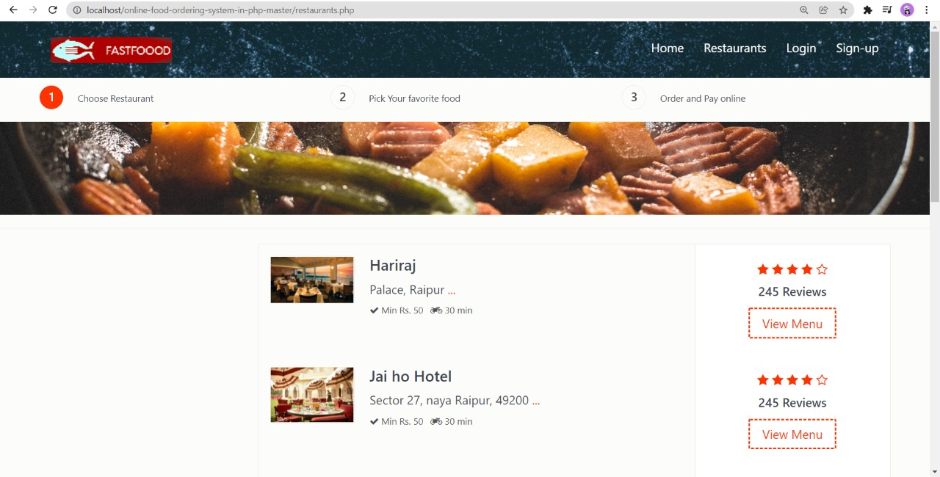
OUTPUT SCREENSHOTS: WEBSITE
REGISTRATION
FORM
STUDENT DETAILS :
AADITYA KUMAR (201010201)
APOORWA GUPTA &
REVANT S EMANY

Slide 12
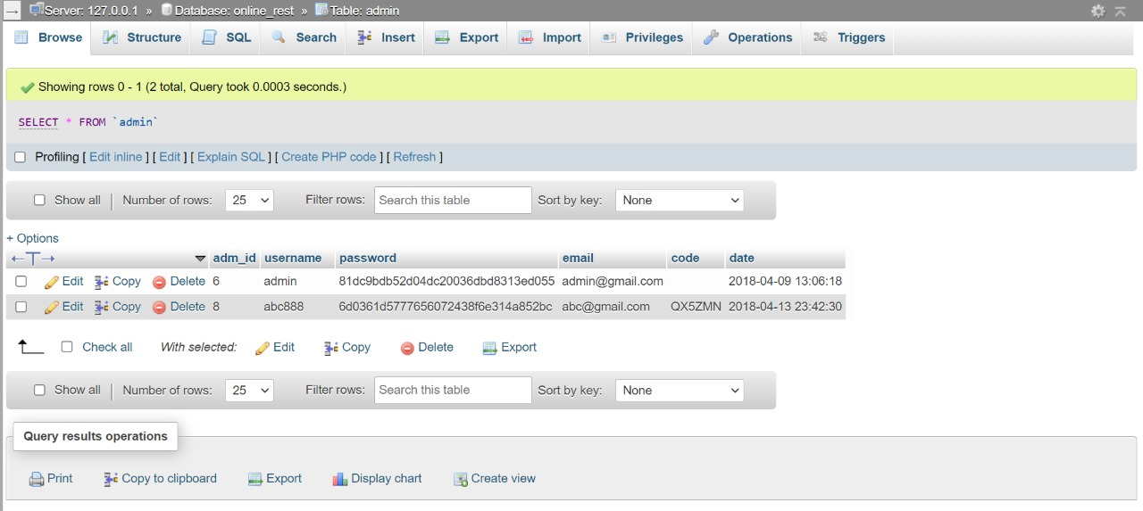
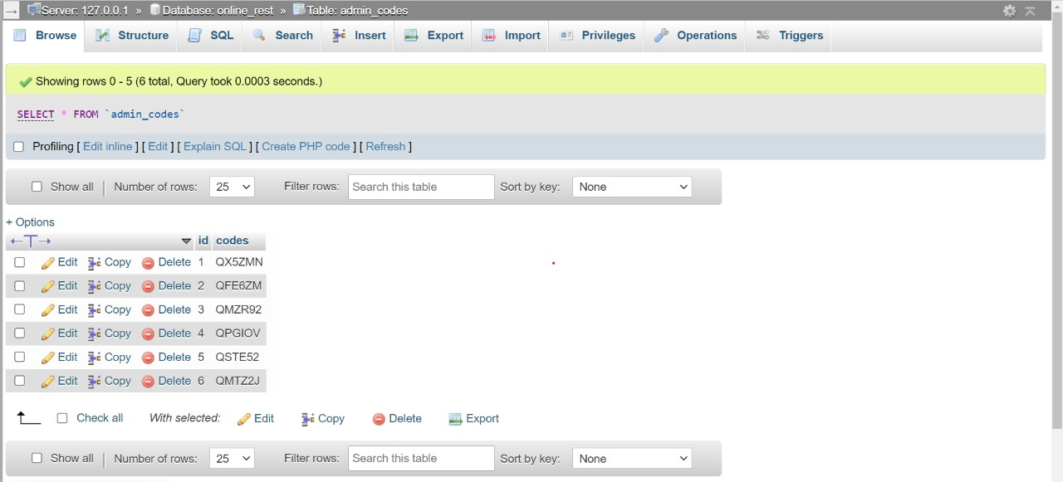
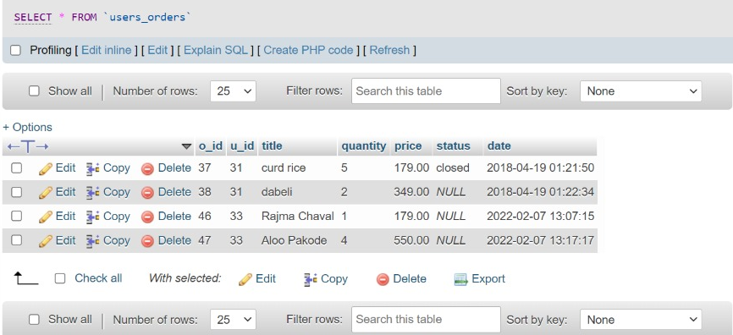
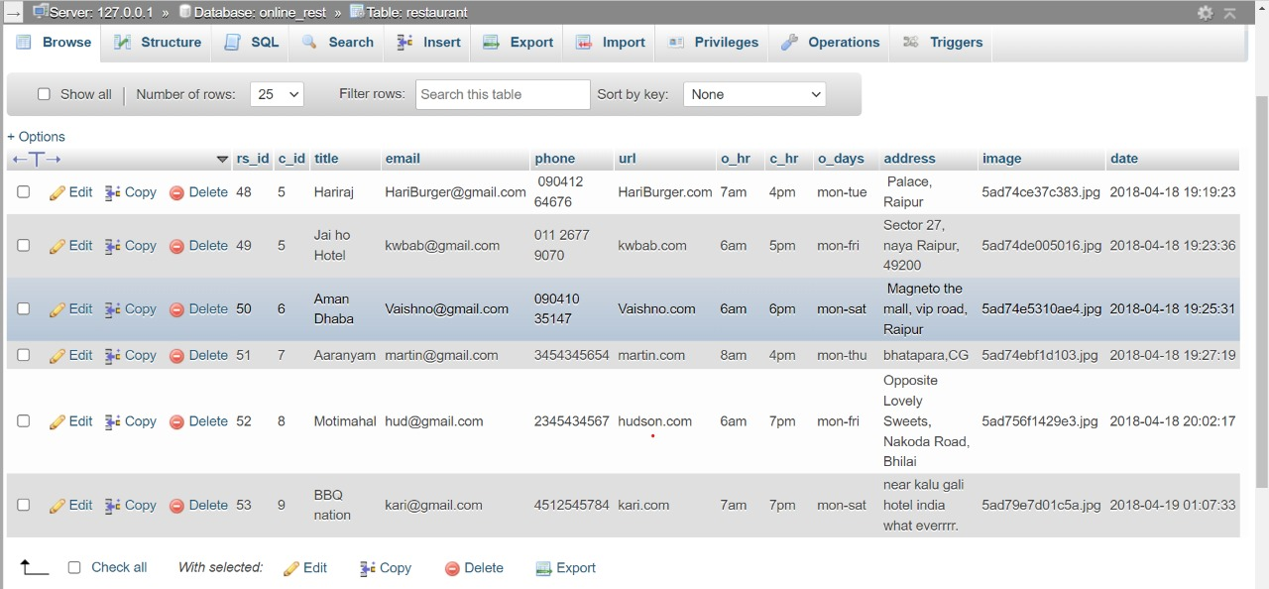
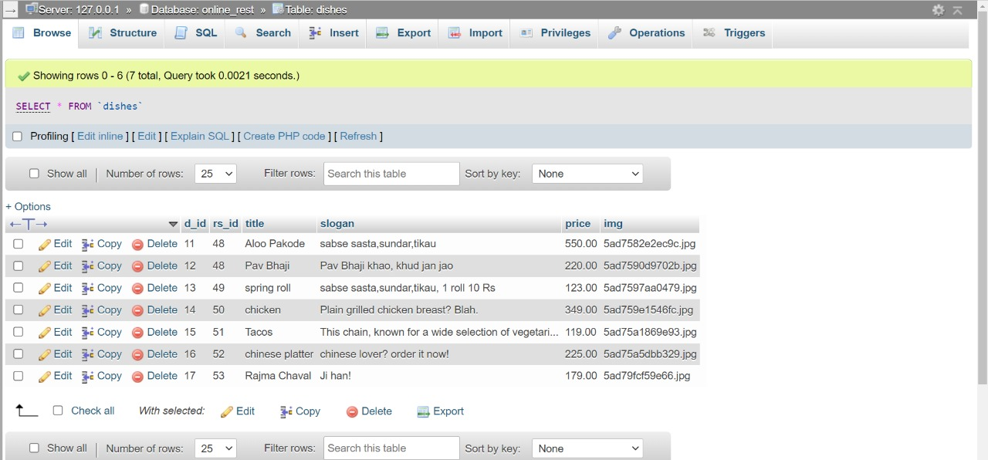
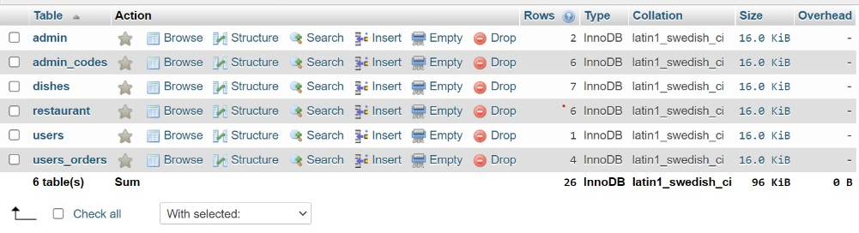
ONLINE FOOD ORDERING SYSTEM
RESULT
Admin Table
Admin_codesTable
User Order Table
List of all Tables
Restaurants Table
Dishes Table

Slide 13
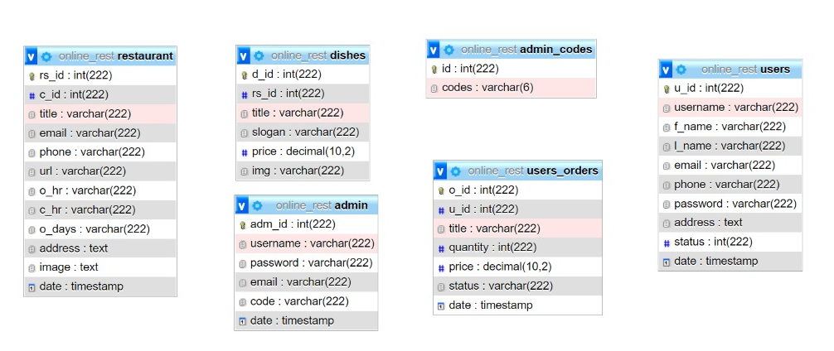
ONLINE FOOD ORDERING SYSTEM
SCHEMA

